Slide 1
NLP Sequence to sequence models lecture 05.2
Branko Žitko
Source: DeepLearning.AI

Slide 2
Contents
Sequence to sequence model
Picking the most likely sentence
Beam search
Refinements to beam search
Error analysis on beam search
Bleu score
Attention model intuition
Attention model

Slide 3


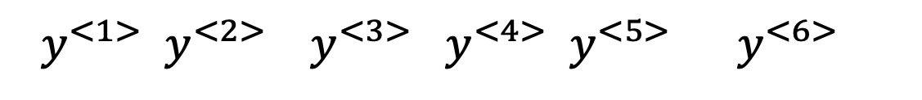

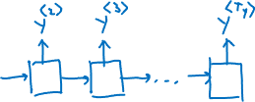

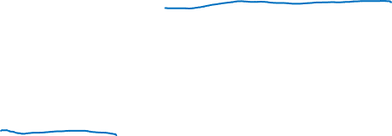


Sequence to sequence model
$x^{<1>}$ $x^{<2>}$ $x^{<3>}$ $x^{<4>}$ $x^{<5>}$
Jane visite l'Afrique en septembre
Jane is visiting Africa in September
$y^{<1>}$ $y^{<2>}$ $y^{<3>}$ $y^{<4>}$ $y^{<5>}$ $y^{<6>}$
$$a^{<0>}$$
…
$$x^{<1>}$$
$$x^{<T_{x}>}$$
[Sutskever et al., 2014. Sequence to sequence learning with neural networks]
[Cho et al., 2014. Learning phrase representations using RNN encoder-decoder for statistical machine translation]

Slide 4
















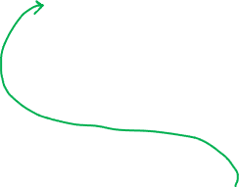
Machine translation as building a conditional language model
$${\hat{y}}^{<1>}$$
$${\hat{y}}^{<2>}$$
$${\hat{y}}^{<T_{y}>}$$
Language model:
…
$$a^{<0>}$$
$$x^{<1>}$$
$${\hat{y}}^{<1>}$$
$${\hat{y}}^{<T_{y}>}$$
Machine translation:
$$a^{<0>}$$
…
…
$$x^{<1>}$$
$$x^{<T_{x}>}$$

Slide 5



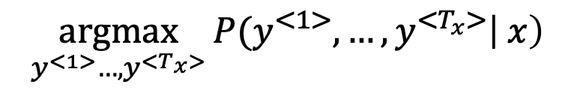
Finding the most likely translation
Jane visite l'Afrique en septembre.
$${P(y}^{<1>}, …,y^{<T_{x}>}\left| x\right)$$
Jane is visiting Africa in September.
Jane is going to be visiting Africa in September.
In September, Jane will visit Africa.
Her African friend welcomed Jane in September.
$$\underset{y^{<1>}…,y^{<T_{x}>}}{argmax}{{P(y}^{<1>}, …,y^{<T_{x}>}\left| x\right)}$$

Slide 6













Why not a greedy search?
$${\hat{y}}^{<1>}$$
$${\hat{y}}^{<T_{y}>}$$
$$a^{<0>}$$
…
…
$$x^{<1>}$$
$$x^{<T_{x}>}$$
Jane is visiting Africa in September.
Jane is going to be visiting Africa in September.

Slide 7

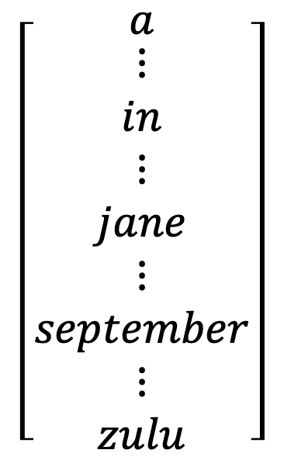

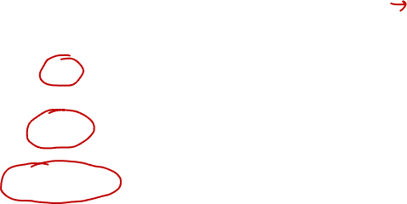





Beam search algorithm
Step 1
$${P(y}^{<1>}\left| x\right)$$
$$\left[\begin{matrix}a \\ \begin{aligned}⋮ \\ in \\ ⋮ \\ jane \\ ⋮ \\ september \\ ⋮ \\ zulu\end{aligned}\end{matrix}\right]$$
$${\hat{y}}^{<1>}$$
$$a^{<0>}$$
…
10000
$$x^{<1>}$$
$$x^{<T_{x}>}$$

Slide 8



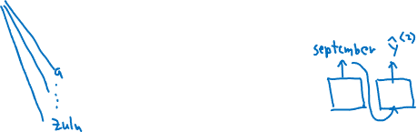



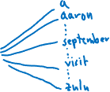

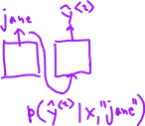



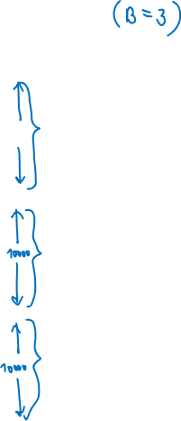





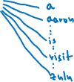






Beam search algorithm
Step 1
Step 2
…
$$a^{<0>}$$
$$\left[\begin{matrix}a \\ \begin{aligned}⋮ \\ in \\ ⋮ \\ jane \\ ⋮ \\ september \\ ⋮ \\ zulu\end{aligned}\end{matrix}\right]$$
$$x^{<1>}$$
$$x^{<T_{x}>}$$
10000
$$a^{<0>}$$
…
$$x^{<1>}$$
$$x^{<T_{x}>}$$
$$a^{<0>}$$
…
$$x^{<1>}$$
$$x^{<T_{x}>}$$

Slide 9




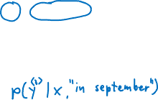









Beam search (B = 3)
in
september
$${\hat{y}}^{<3>}$$
in september
$$a^{<0>}$$
…
$$x^{<1>}$$
$$x^{<T_{x}>}$$
jane
is
$${\hat{y}}^{<3>}$$
jane is
$$a^{<0>}$$
…
$$x^{<1>}$$
$$x^{<T_{x}>}$$
jane
visits
$${\hat{y}}^{<3>}$$
jane visits
$$a^{<0>}$$
…
$$x^{<1>}$$
$$x^{<T_{x}>}$$
$$P\left(y^{<1>},y^{<2>}|x\right)$$
jane visits africa in september. <EOS>

Slide 10

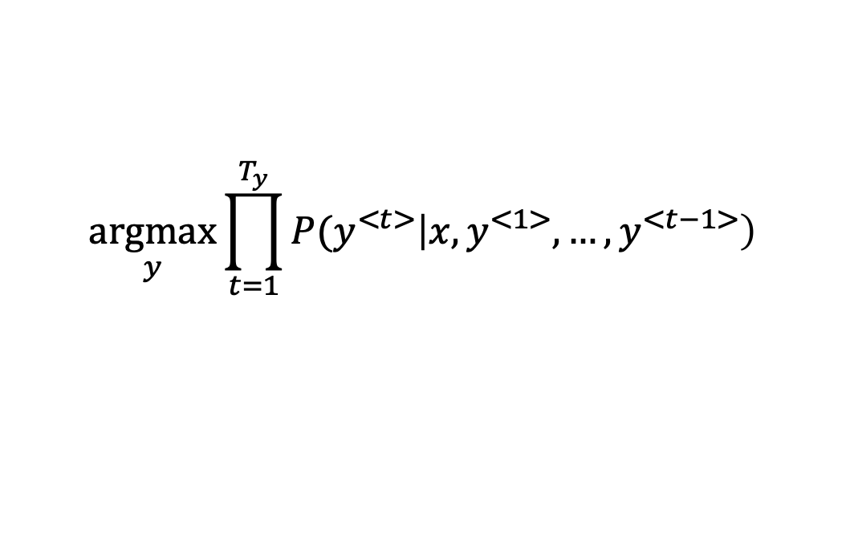

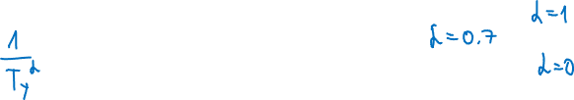

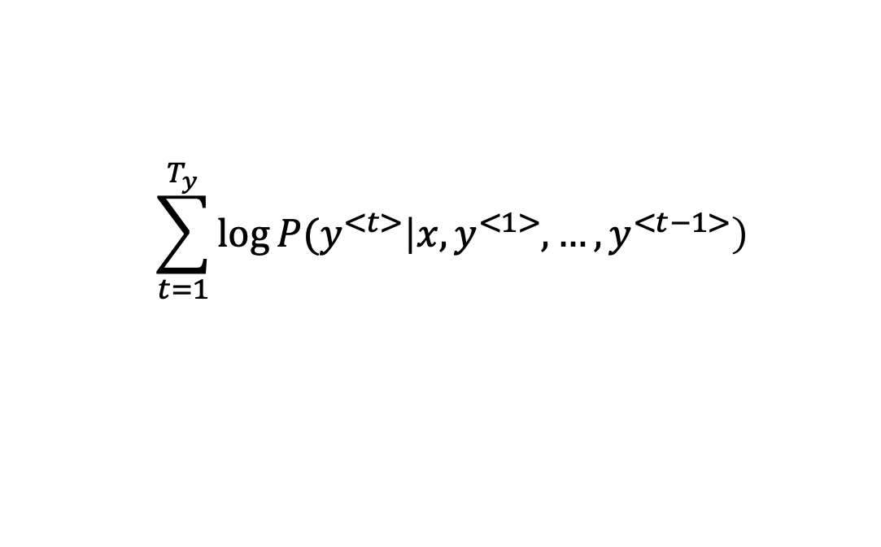


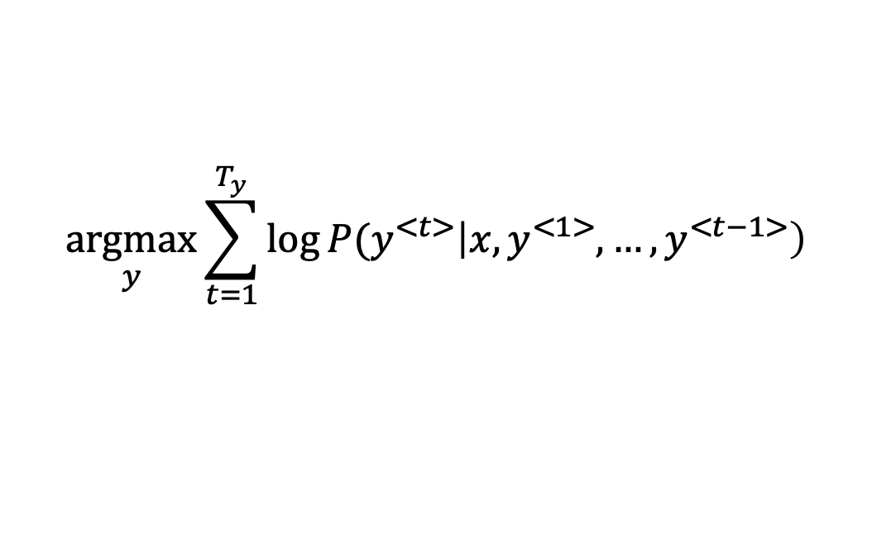

Length normalization
$$\underset{y}{argmax}{\prod_{t=1}^{T_{y}}{{P(y}^{<t>}\left|x,y^{<1>},…,y^{<t−1>}\right)}}$$
$$\underset{y}{argmax}{\sum_{t=1}^{T_{y}}{\log{{P(y}^{<t>}\left|x,y^{<1>},…,y^{<t−1>}\right)}}}$$
$$\sum_{t=1}^{T_{y}}{\log{{P(y}^{<t>}\left|x,y^{<1>},…,y^{<t−1>}\right)}}$$

Slide 11
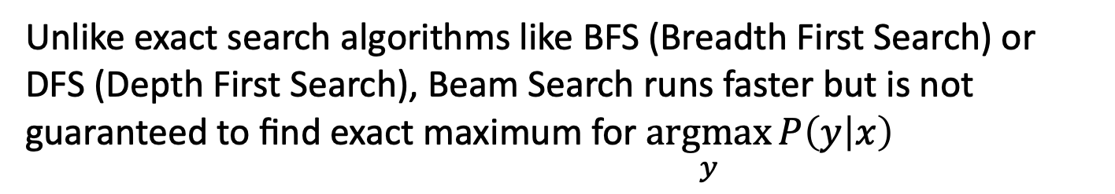

Beam search discussion
Beam width B?
Unlike exact search algorithms like BFS (Breadth First Search) or DFS (Depth First Search), Beam Search runs faster but is not guaranteed to find exact maximum for $\underset{y}{argmax}{P\left(y | x\right)}$

Slide 12


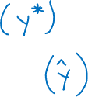



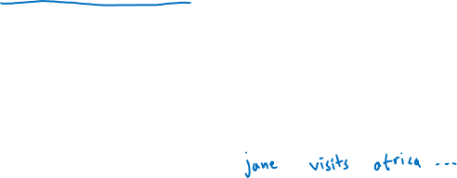


Error analysis on beam search
Jane visite l'Afrique en septembre.
Human: Jane visits Africa in September.
Algorithm: Jane visited Aftica last September.
$$a^{<0>}$$
…
$$x^{<1>}$$
$$x^{<T_{x}>}$$

Slide 13
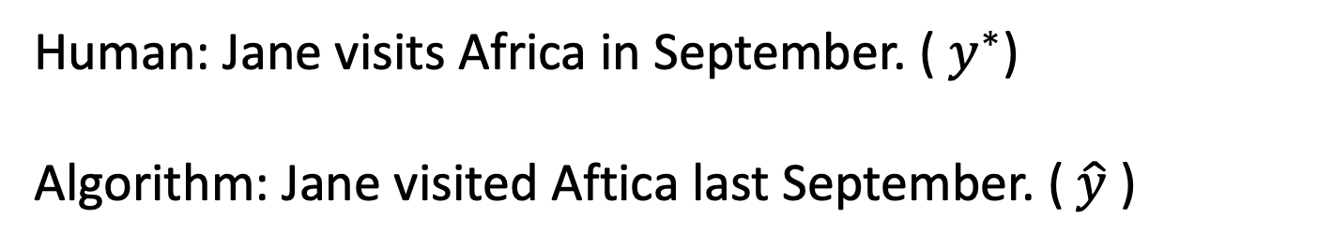
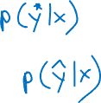
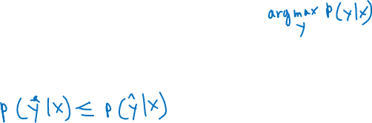
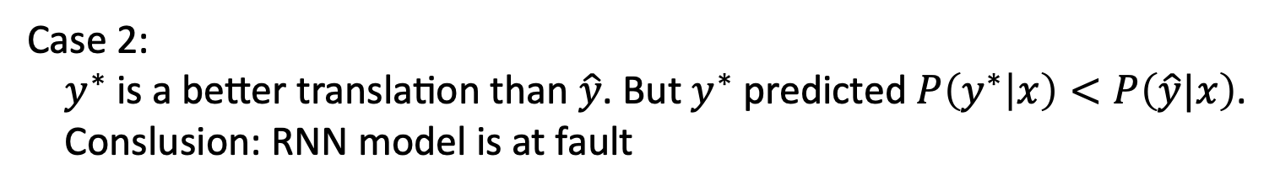
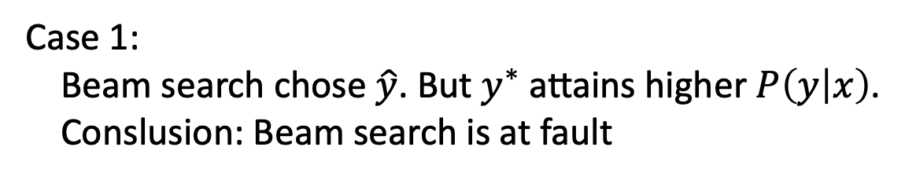

Error analysis on beam search
Human: Jane visits Africa in September. ( $y^{∗}$)
Algorithm: Jane visited Aftica last September. ($\hat{y}$ )
Case 1:
Beam search chose $\hat{y}$. But $y^{∗}$ attains higher $P\left(y | x\right)$.
Conslusion: Beam search is at fault
Case 2:
$y^{∗}$ is a better translation than $\hat{y}$. But $y^{∗}$ predicted $P\left(y^{∗} | x\right)<P\left(\hat{y}|x\right)$.
Conslusion: RNN model is at fault

Slide 14




Error analysis process
Human Algorithm $P\left(y^{∗} | x\right)$ $P\left(\hat{y}|x\right)$ At fault?
Jane visits Africa in September.
Jane visited Aftica last September.
Figures out what faction of errors are "due to" beam search vs. RNN model

Slide 15
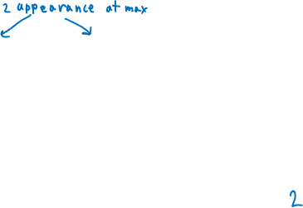
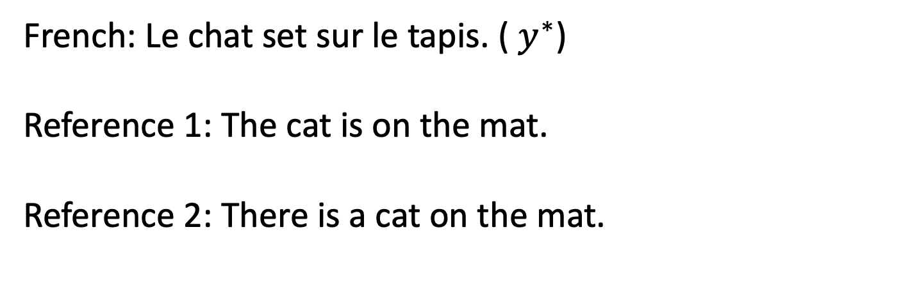

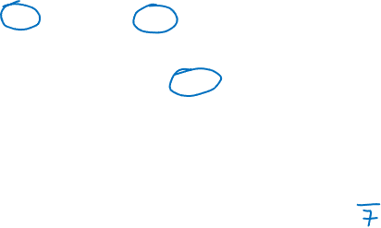


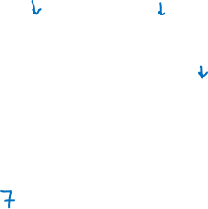
Evaluating machine translation
French: Le chat set sur le tapis. ( $y^{∗}$)
Reference 1: The cat is on the mat.
Reference 2: There is a cat on the mat.
MT output: the the the the the the the.
Precision:
Modified precision:
[Papineni et. al., 2002. Bleu: A method for automatic evaluation of machine translation]

Slide 16

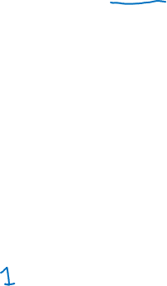
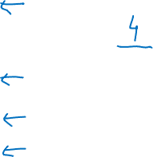
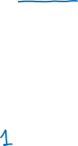
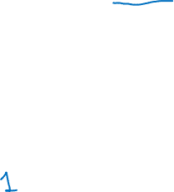
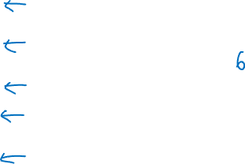
BLEU score on bigrams
Example:
Reference 1: The cat is on the mat.
Reference 2: There is a cat on the mat.
MT output: the cat the cat on the mat.
the cat
cat the
cat on
on the
the mat
[Papineni et. al., 2002. Bleu: A method for automatic evaluation of machine translation]

Slide 17

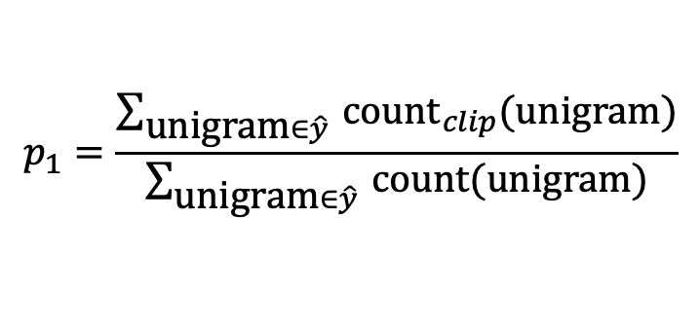

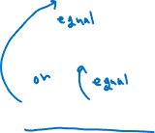
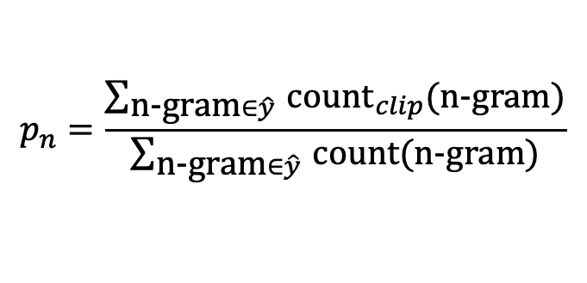
BLEU score on unigrams
Example:
Reference 1: The cat is on the mat.
Reference 2: There is a cat on the mat.
MT output: the cat the cat on the mat.
$$p_{1}=\frac{\sum_{\text{u}\text{nigram}∈\hat{y} }{\text{coun}{\text{t}}_{clip}(\text{unigram})}}{\sum_{\text{u}\text{nigram}∈\hat{y} }{\text{count}(\text{unigram})}}$$
$$p_{n}=\frac{\sum_{\text{n}\text{−}\text{gram}∈\hat{y} }{\text{coun}{\text{t}}_{clip}(\text{n}\text{−}\text{gram})}}{\sum_{\text{n}\text{−}\text{gram}∈\hat{y} }{\text{count}(\text{n}\text{−}\text{gram})}}$$
[Papineni et. al., 2002. Bleu: A method for automatic evaluation of machine translation]

Slide 18

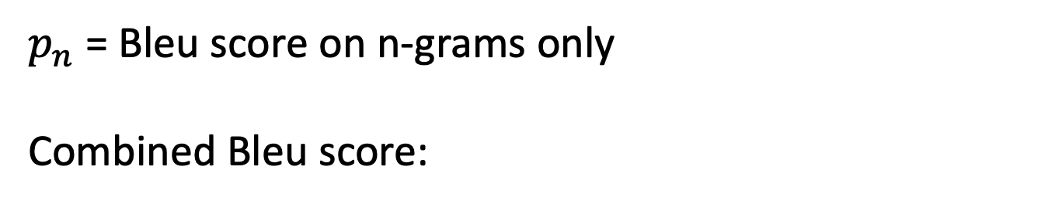


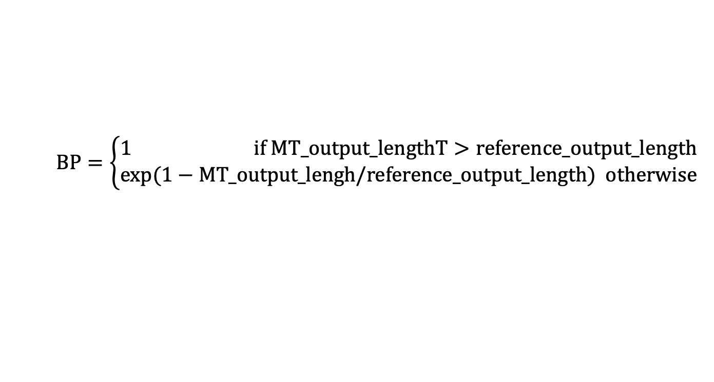
BLEU details
$p_{n}$ = Bleu score on n-grams only
Combined Bleu score:
$$\text{BP}=\left\{\begin{aligned}1 \text{if} \text{MT}\text{_}\text{output}\text{_}\text{lengthT}>\text{reference}\text{_}\text{output}\text{_}\text{length} \\ \exp{(1−\text{MT}\text{_}\text{output}\text{_}\text{lengh}\text{/}\text{reference}\text{_}\text{output}\text{_}\text{length}}) \text{otherwise}\end{aligned}\right.$$
[Papineni et. al., 2002. Bleu: A method for automatic evaluation of machine translation]

Slide 19









The problem of long sequences
$${\hat{y}}^{<1>}$$
$${\hat{y}}^{<T_{y}>}$$
$$a^{<0>}$$
…
…
$$x^{<1>}$$
$$x^{<T_{x}>}$$
Jane s'est rendue en Afrique en septembre dernier, a apprécié la culture et a rencontré beaucoup de gens merveilleux; elle est revenue en parlant comment son voyage était merveilleux, et elle me tente d'y aller aussi.
Jane went to Africa last September, and enjoyed the culture and met many wonderful people; she came back raving about how wonderful her trip was, and is tempting me to go too.
Bleu
score
Sentence
length
10
20
30
40
50

Slide 20
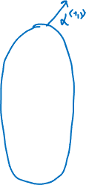

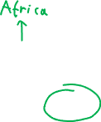





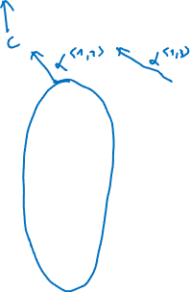


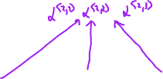

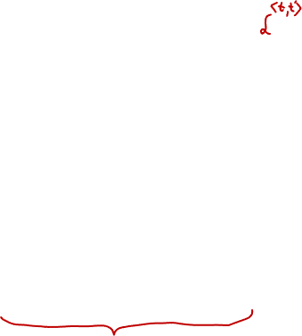

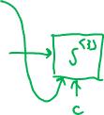






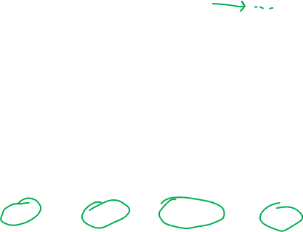


Attention model intuition
$${\hat{y}}^{<1>}$$
$${\hat{y}}^{<2>}$$
$${\hat{y}}^{<3>}$$
$${\hat{y}}^{<4>}$$
$${\hat{y}}^{<5>}$$
$$a^{<0>}$$
$$x^{<1>}$$
$$x^{<2>}$$
$$x^{<3>}$$
$$x^{<4>}$$
$$x^{<5>}$$
jane
visite
l'Afrique
en
septembre
[Bahdanau et. al., 2014. Neural machine translation by jointly learning to align and translate]

Slide 21

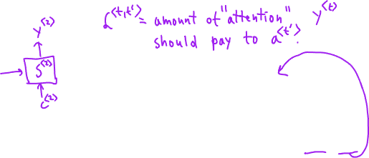

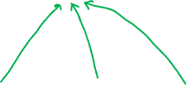
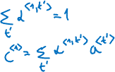




Attention model
$$a^{<0>}$$
$$x^{<1>}$$
$$x^{<2>}$$
$$x^{<3>}$$
$$x^{<4>}$$
$$x^{<5>}$$
jane
visite
l'Afrique
en
septembre
[Bahdanau et. al., 2014. Neural machine translation by jointly learning to align and translate]

Slide 22












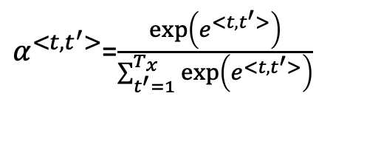


Computing attention $α^{<t, t^{′}>}$
$α^{<t, t^{′}>}$ = amount of attention $y^{<t>}$ should pay to $a^{<t^{′}>}$
$α^{<t, t^{′}>}$=$\frac{\exp\left(e^{<t, t^{′}>}\right)}{\sum_{t^{′}=1}^{T_{x}}{\exp\left(e^{<t, t^{′}>}\right)}}$
$${\hat{y}}^{<t−1>}$$
$${\hat{y}}^{<t>}$$
$$s^{<t−1>}$$
$$s^{<t>}$$
$$s^{<t−1>}$$
$$e^{<t, t^{′}>}$$
$$a^{<t^{′}>}$$
$$a^{<0>}$$
…
$$x^{<1>}$$
$$x^{<2>}$$
$$x^{<T_{x}−1>}$$
$$x^{<T_{x}>}$$
[Bahdanau et. al., 2014. Neural machine translation by jointly learning to align and translate]
[Xu et. al., 2015. Show, attend and tell: Neural image caption generation with visual attention]

Slide 23


Attention examples
July 20th 1969
1969 – 07 – 20
23 April, 1564
1564 – 04 – 23
Visualization of $a^{<t, t^{′}>}$:

